Slide 1
Order Visibility Dashboard
MEDI-CAPS UNIVERSITY
Presented to :
Prof. Prasanna Kapse
PROJECT WORK – II
CS3PC02
COMPUTER SCIENCE AND ENGG. - E

Slide 2

Introduction
Internship Details
A 6 – month virtual internship program.
Organisation name :-
WM Global Technology Services Pvt. Ltd., Banglore, India
Contact Person : -
Rishabh Subramaniam Hariharan – HR

Slide 3
Introduction
Order Visibility Dashboard is a website basically designed for backend team. Sometimes what happens is there is some failure in backend code and the developers are not able to find that where the problem is, which leads to huge wastage of time and resource for developers.
Order Visibility Dashboard, thus logs all the events that occurs corresponding to an order-id irrespective of their completion status i.e ‘FAILED’, ’SUCCESS’ or ‘INITIATED’. This will ease almost half of the load for developers, as they will know that at which point their system is failing and can easily resolve the issues.

Slide 4

Order Visibility Dashboard

Slide 5

Problem Statement
Develop a website in which :
Backend team can view or log all the events associated with a particular order-id.

Slide 6
Technologies used
TECHNOLOGIES :
FrontEnd – HTML, CSS, JavaScript, React
BackEnd – Java
Database - Elasticsearch

Slide 7
Diagrams
Below is the list of some diagrams that we have drawn in context with our project :-
Use – Case Diagram
Activity Diagram
Class Diagram
Sequence Diagram

Slide 8
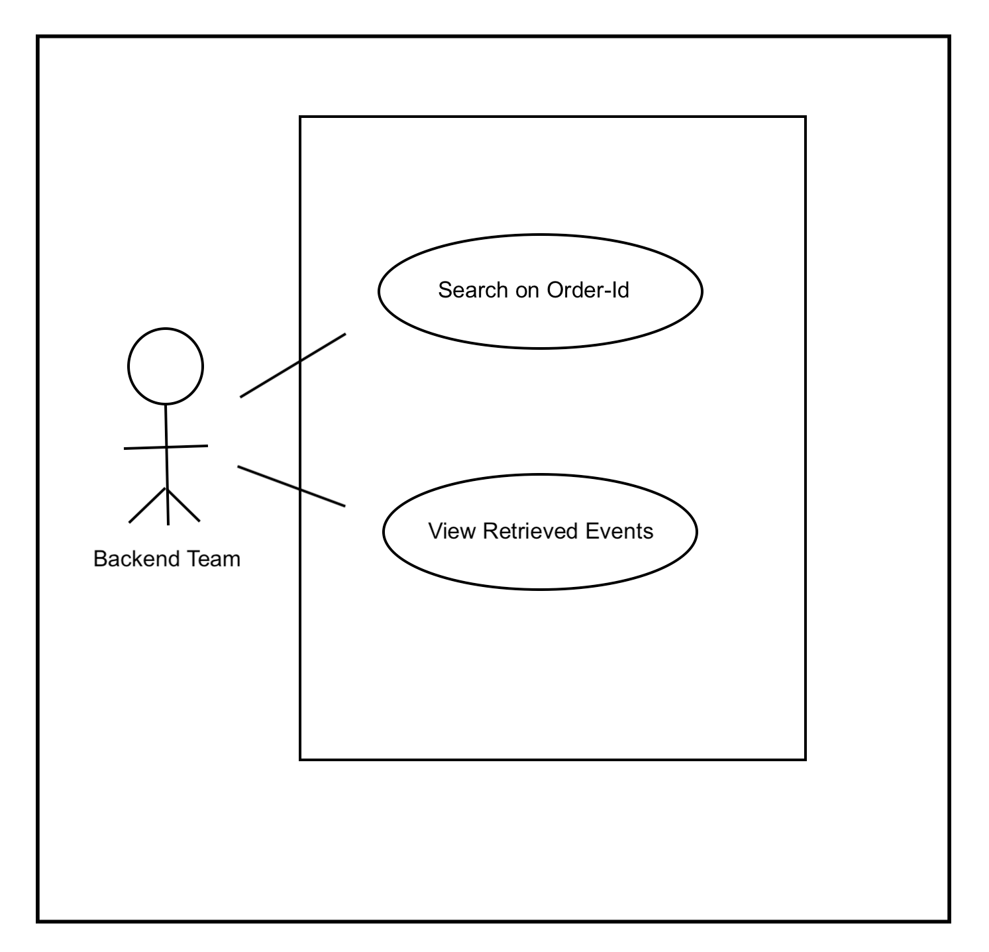
Use case Diagram

Slide 9
Use case Description
Use Case ID : 1
Search on Order Id
Brief Description
This use case allows a developer from backend team to view all his requirements on basis of the order Id, for a particular order that moved into the system.
Flow Of Events
Basic Flow
The user enters an order id, on which he/she wants to perform a search on.
The system reads the entered order id and passes it to backend side to fetch results.

Slide 10
Use case Description
Alternative Flow
Invalid Order Id
If, in the Basic Flow, the user enters an invalid order id that neither exist nor have any data associated with it, then the system displays an error message stating “Order Id Doesn’t Exist”. The user can either choose to return to the beginning of basic flow or can exit, at which point the use case ends.
Pre-Conditions
The system is in the search state and has the search screen displayed.
Post-Conditions
If the use case is successful, the user was able to search his requirements. If not, the system state is unchanged.
Extension Points
None

Slide 11
Use case Description
Use Case Id : 2
View Retrieved Events
Brief Description
This use case allows a developer from backend team to view all his requirements that he searched for, on order id.
Flow Of Events
Basic Flow
The system displays the required fetched result to the user.

Slide 12
Use case Description
Pre-Conditions
The system is in the display state and has results displayed.
Post-Conditions
If the use case is successful, the user was able to view the results. If not, the system state is unchanged.
Extension Points
None

Slide 13
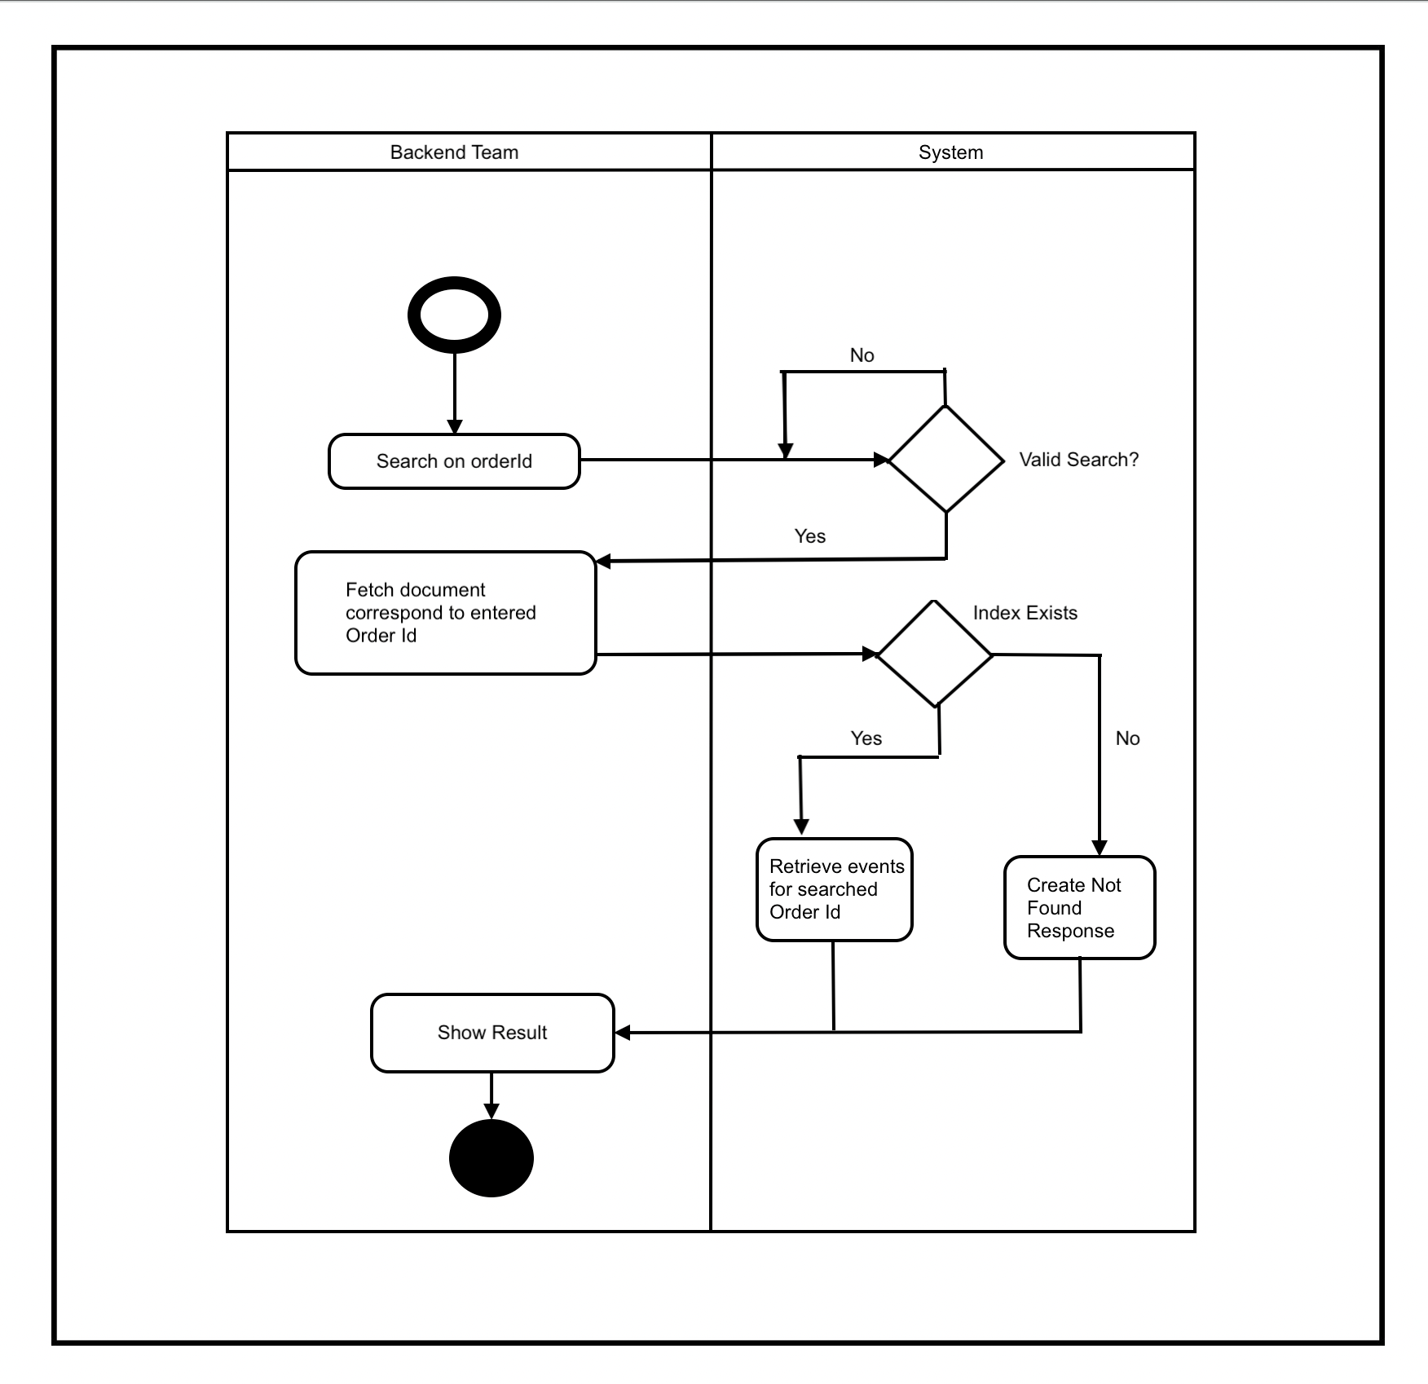
Activity Diagram

Slide 14
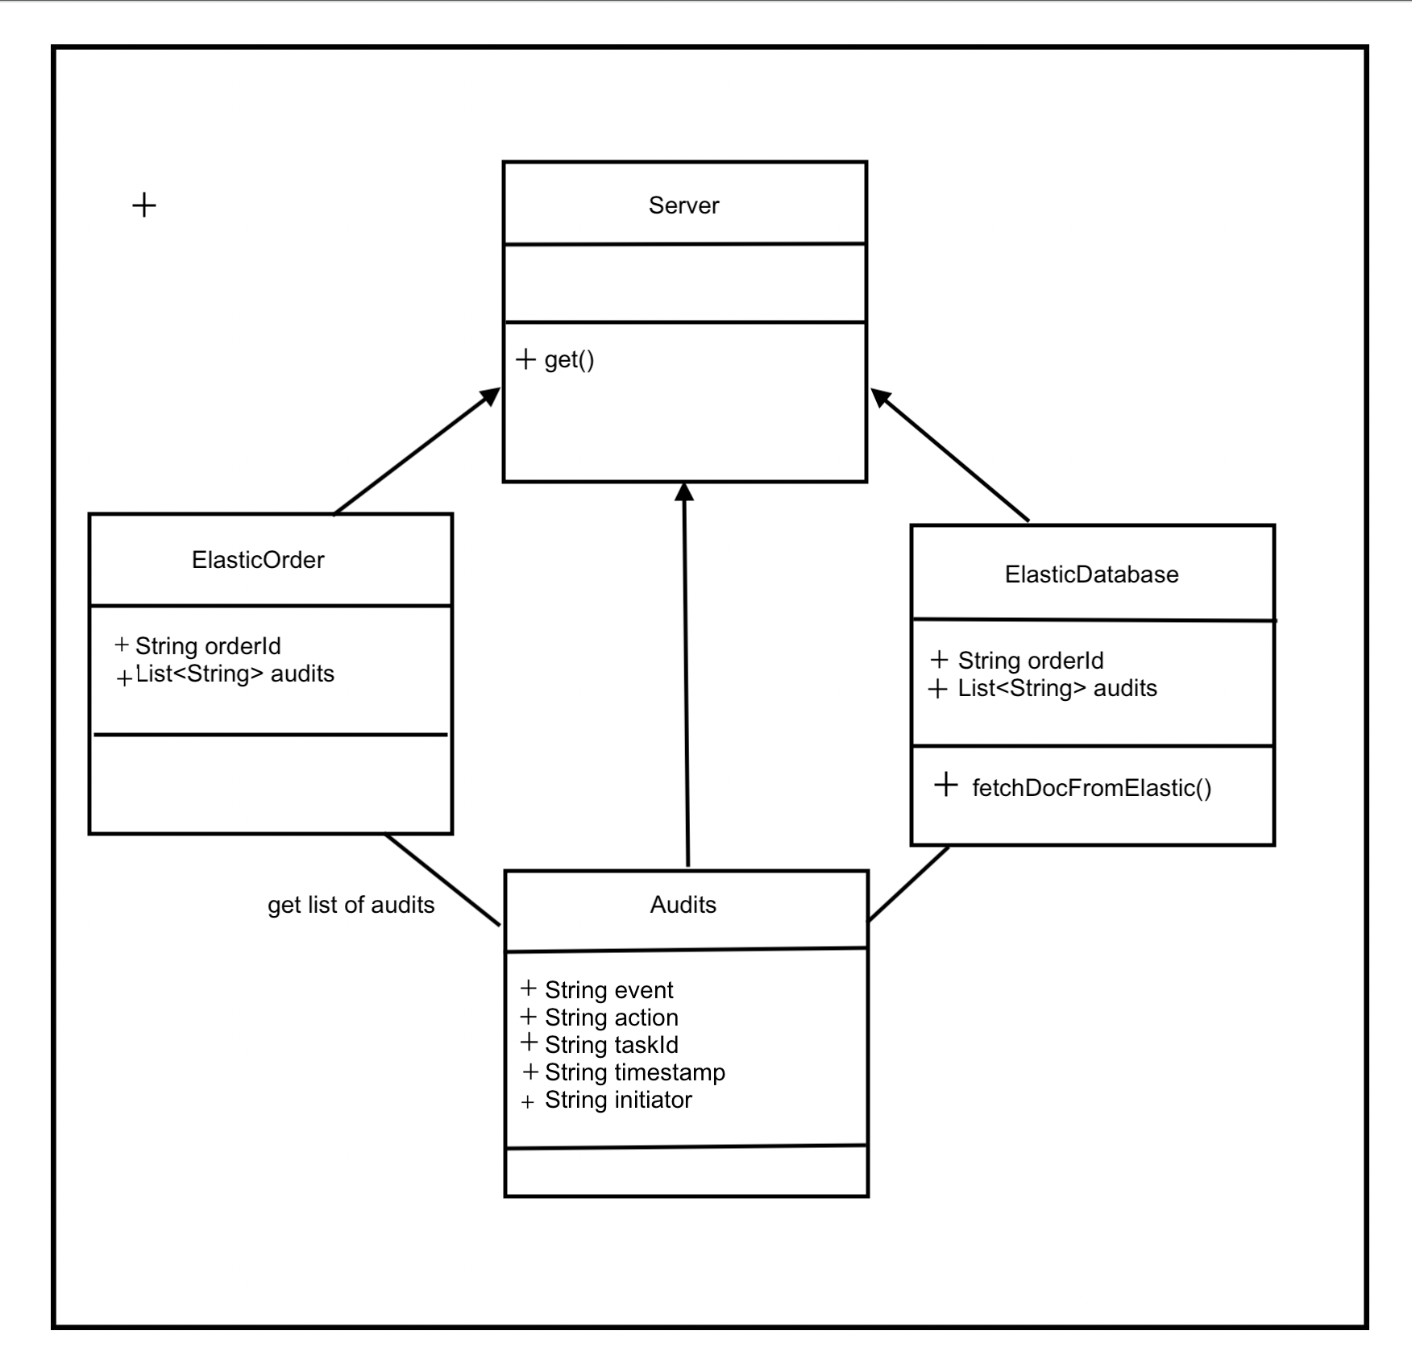
Class Diagram

Slide 15
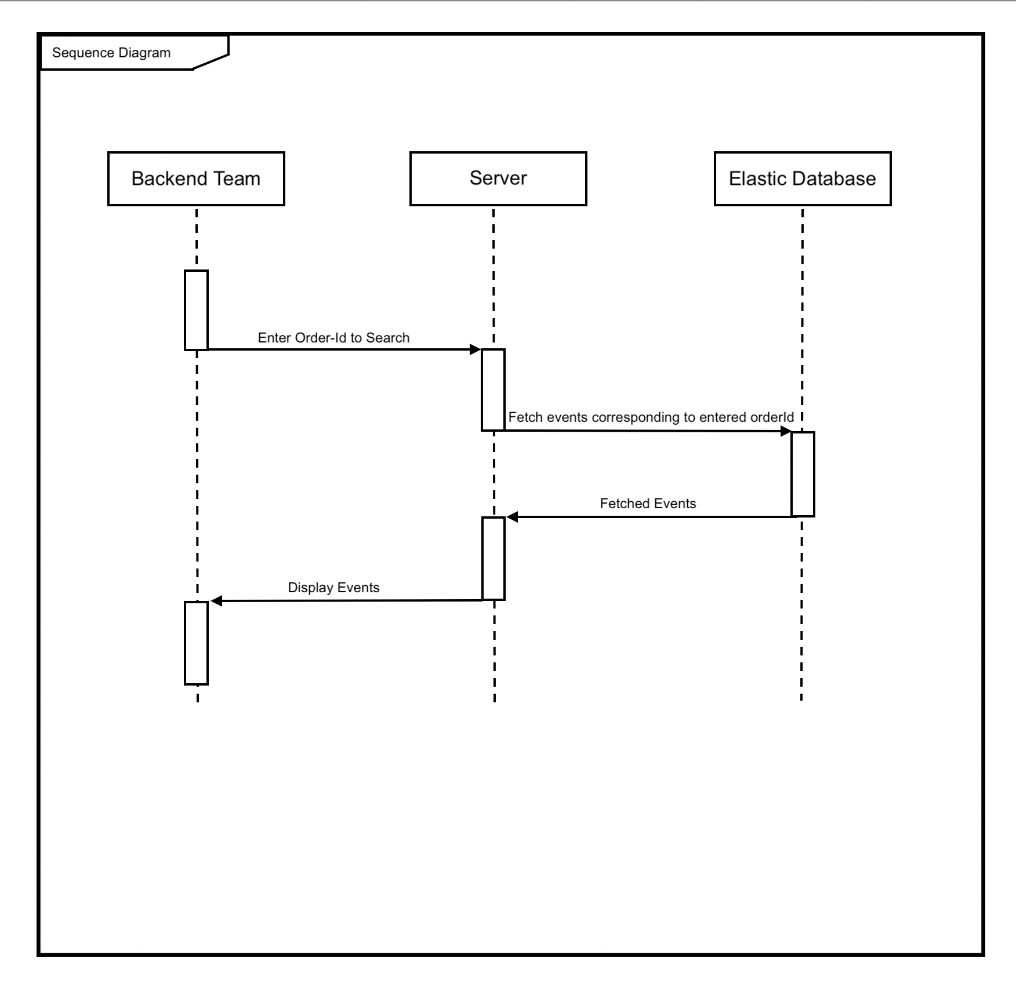
sequence Diagram

Slide 16
Functional requirements
Search On OrderId
View Retrieved Logs
The backend team can search event logs for a particular orderId.
The backend team can view descriptive details for all the fetched events.
1
2

Slide 17
Non – functional requirements
Reliability
The system shall be available 24 hours a day, 7 days a week, with no more than 8% down time.
Performance
The system shall support up to 1000 simultaneous users against at any given time, and up to 2000 simultaneous users against the local servers at any one time.

Slide 18
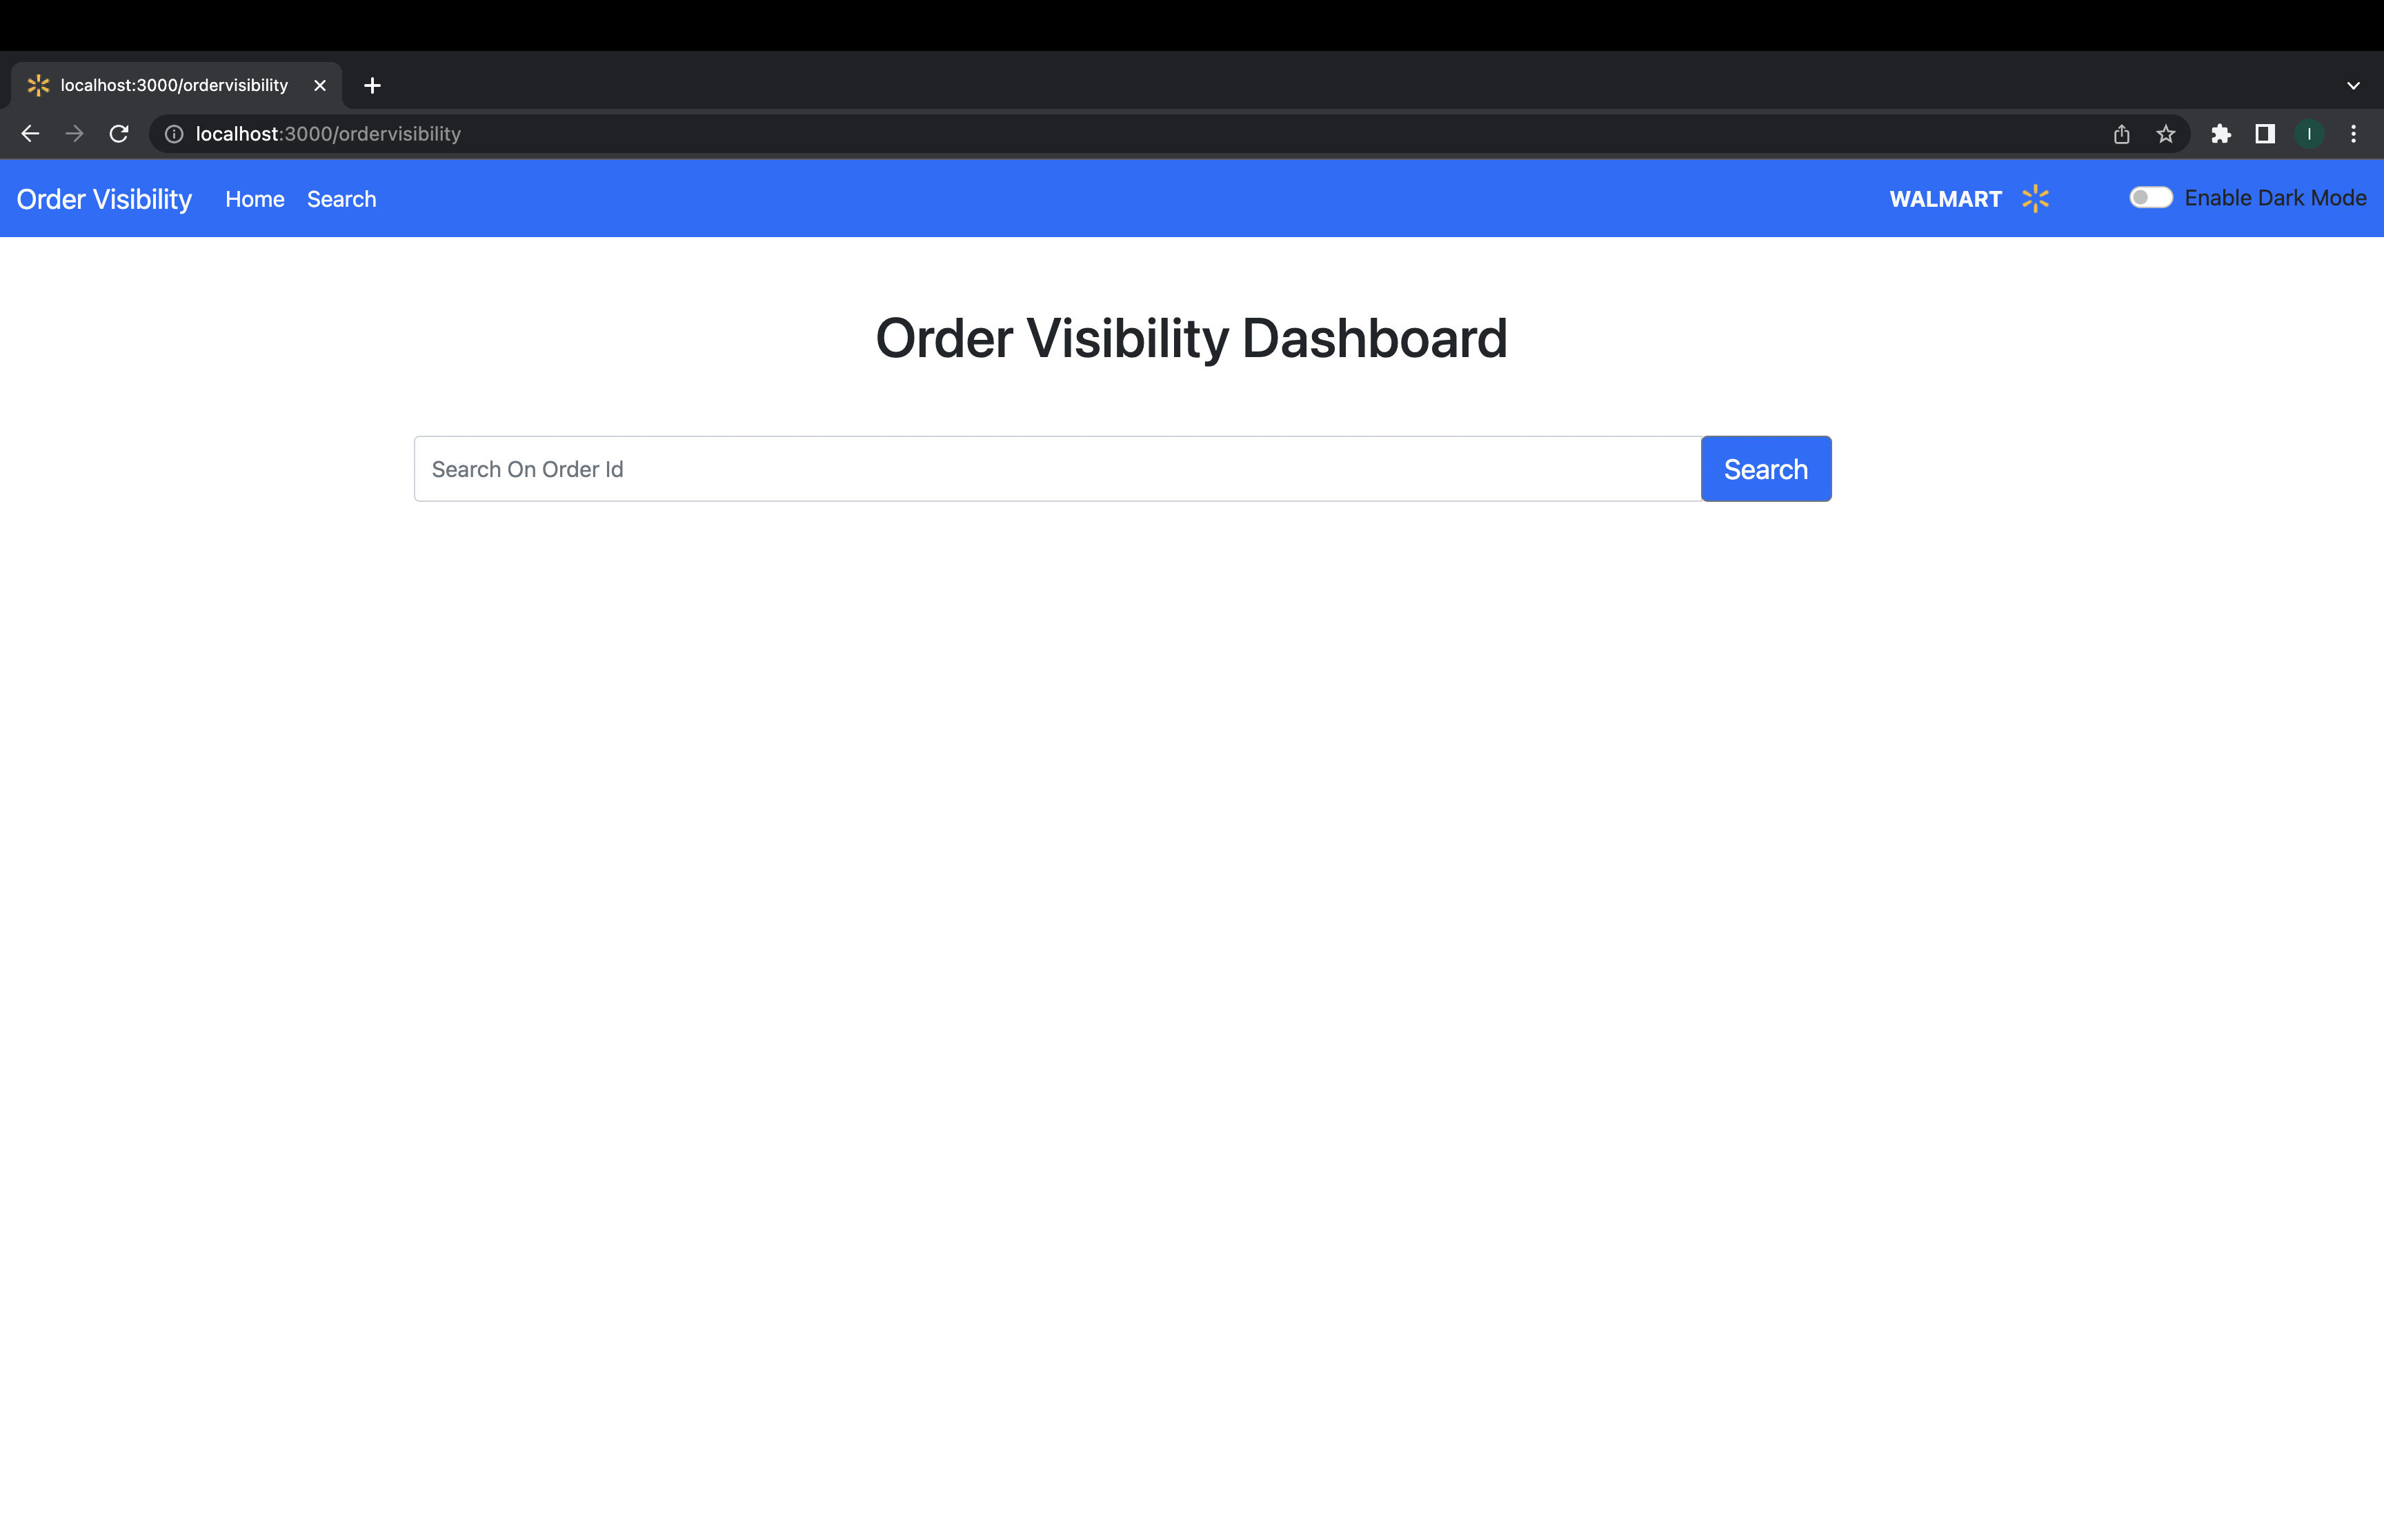
Snapshots for project

Slide 19
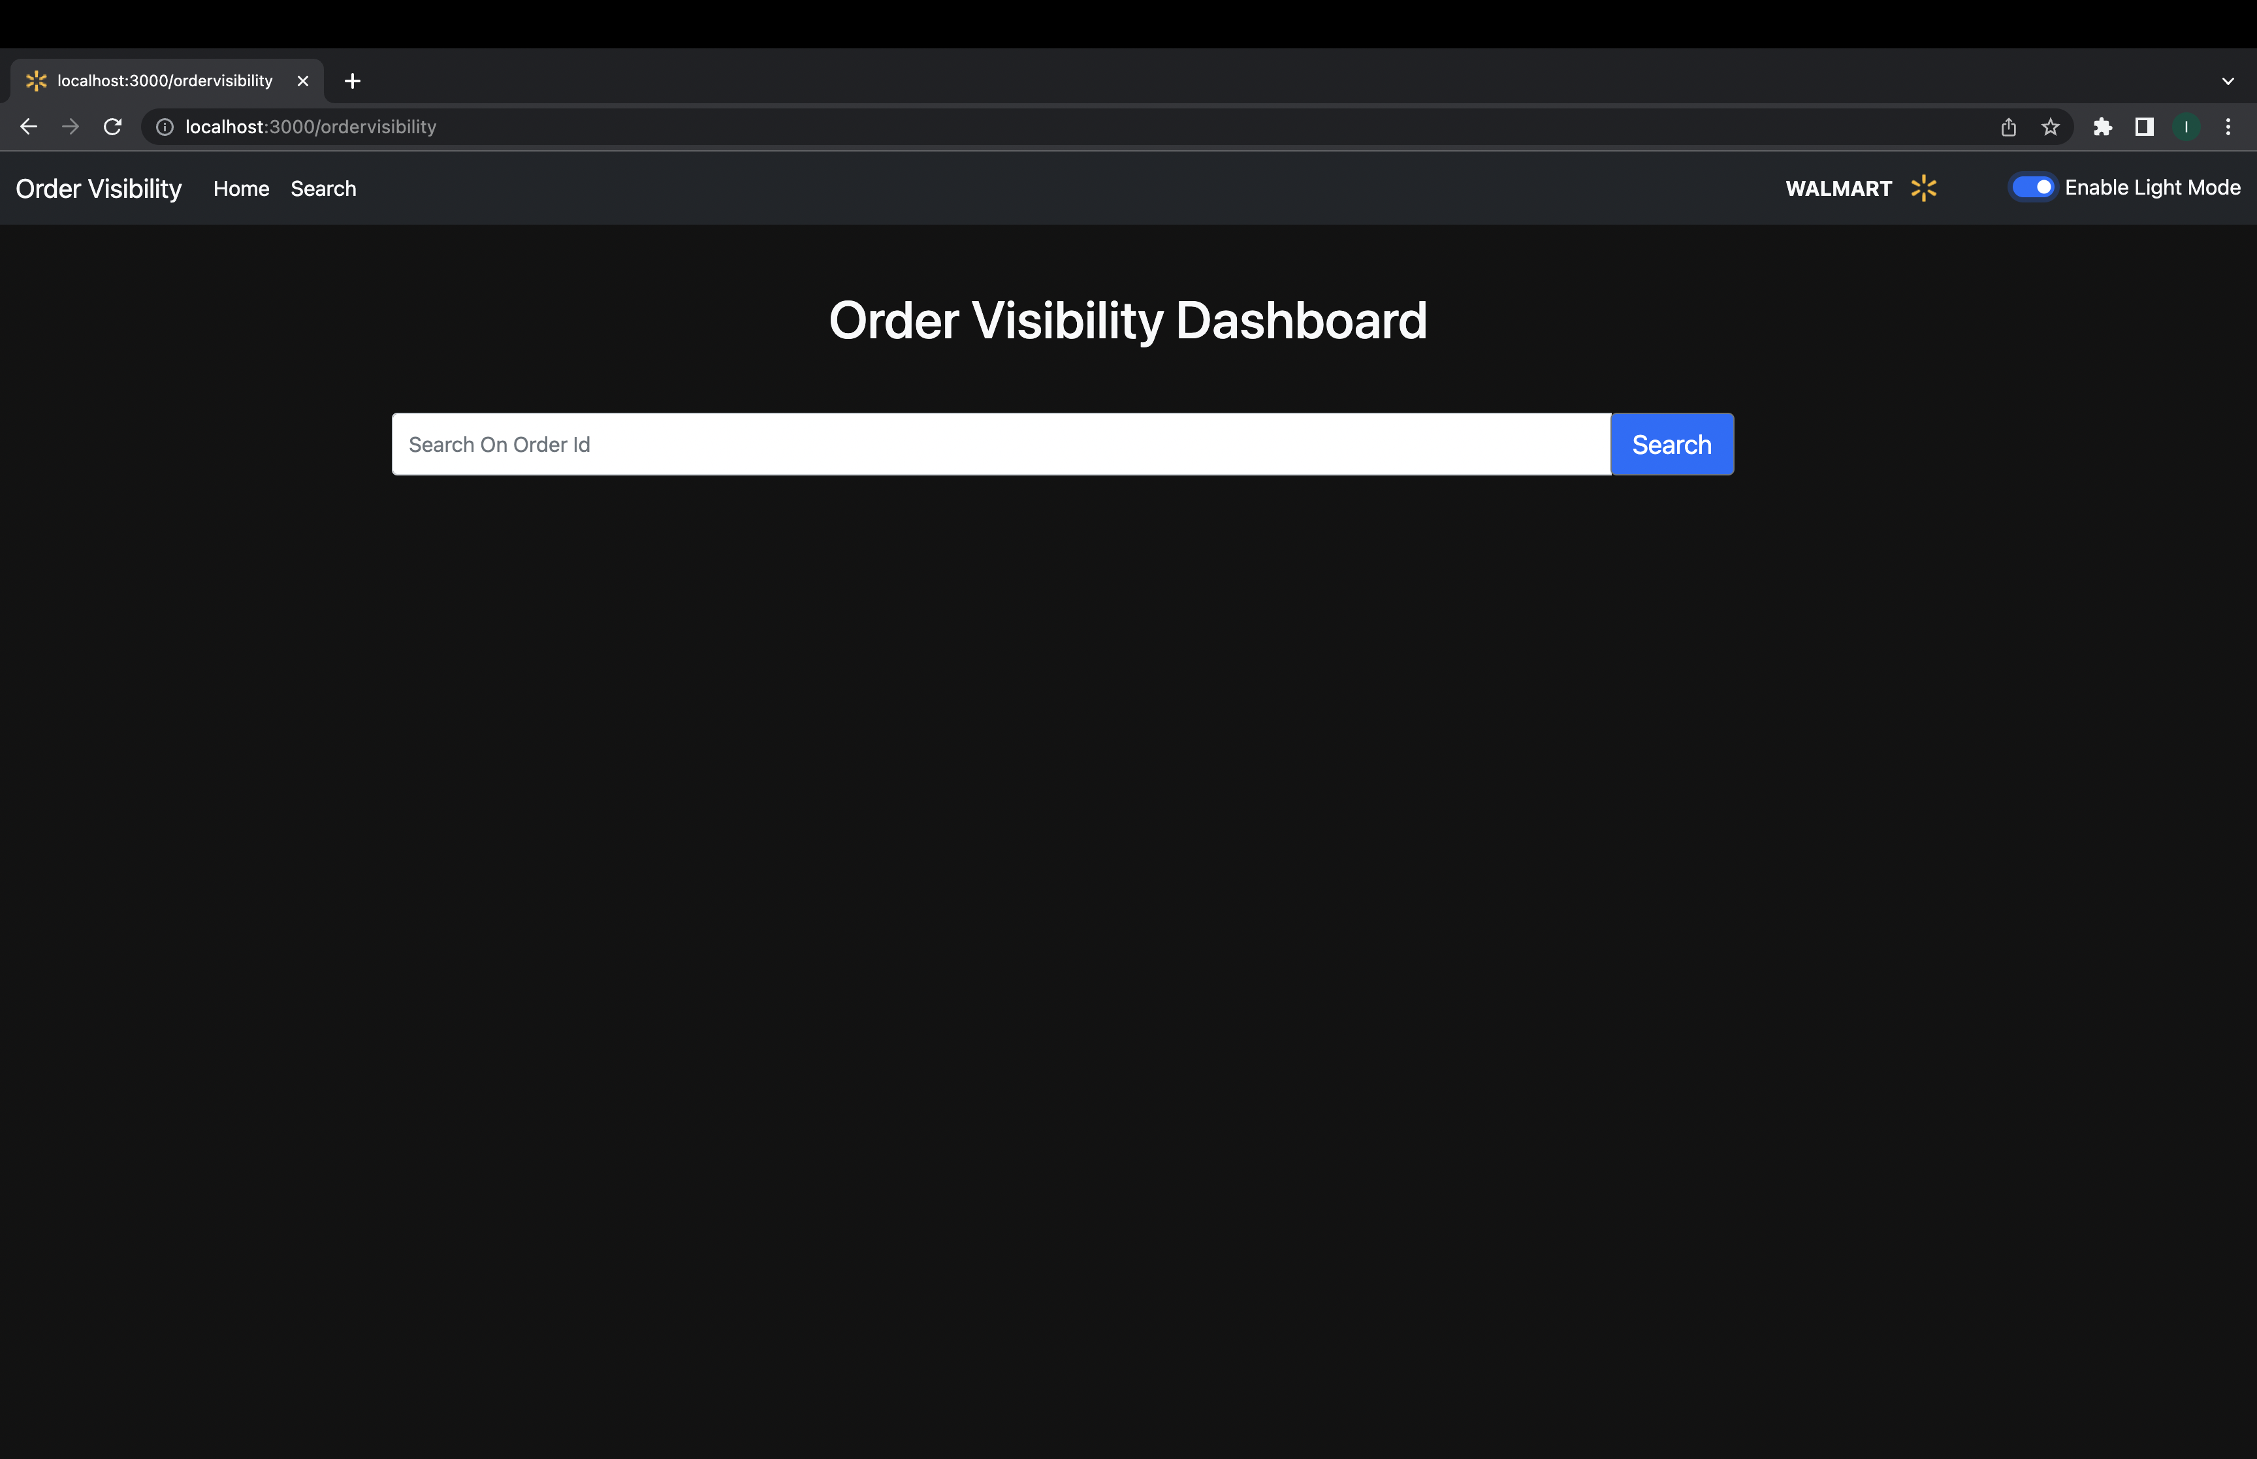
Snapshots for project

Slide 20
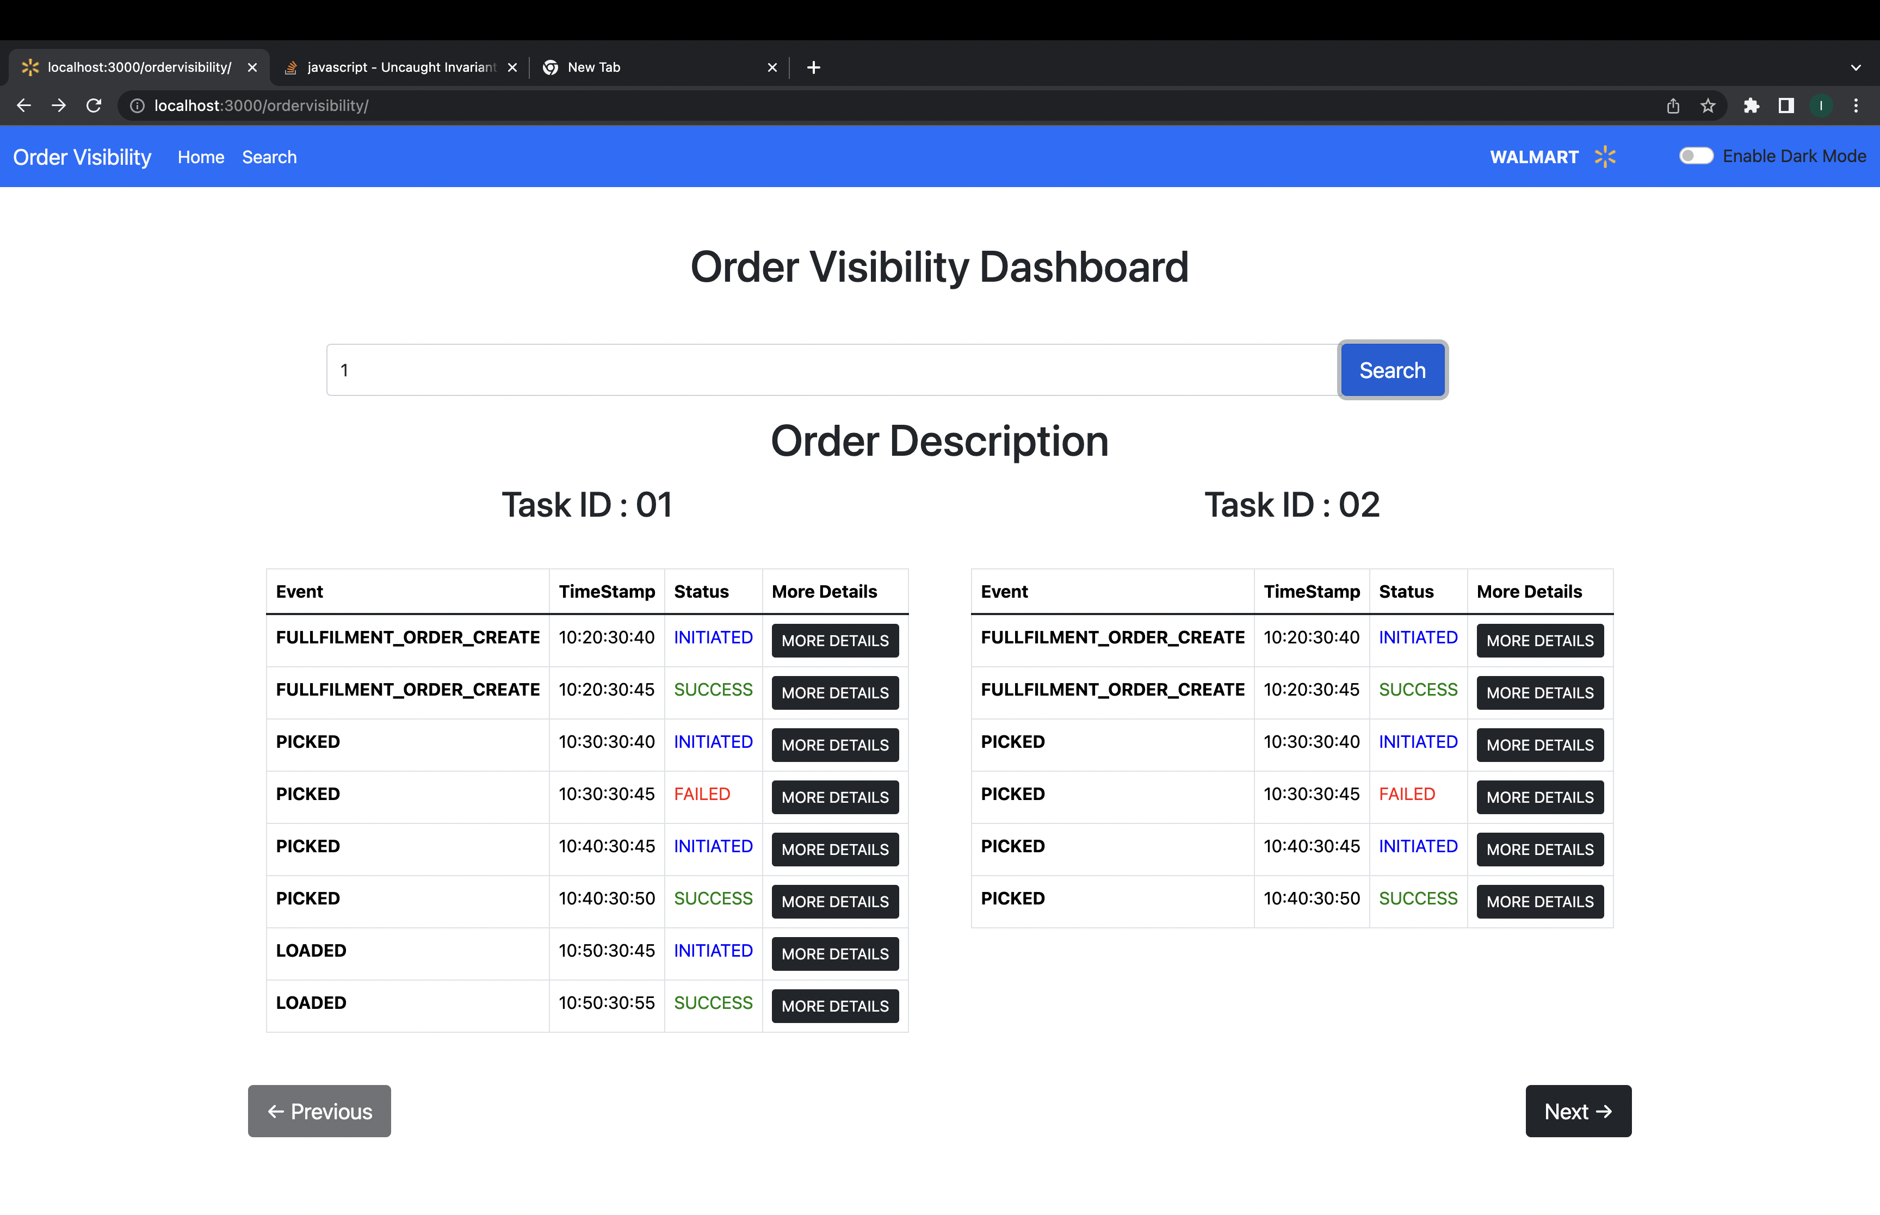
Snapshots for project

Slide 21
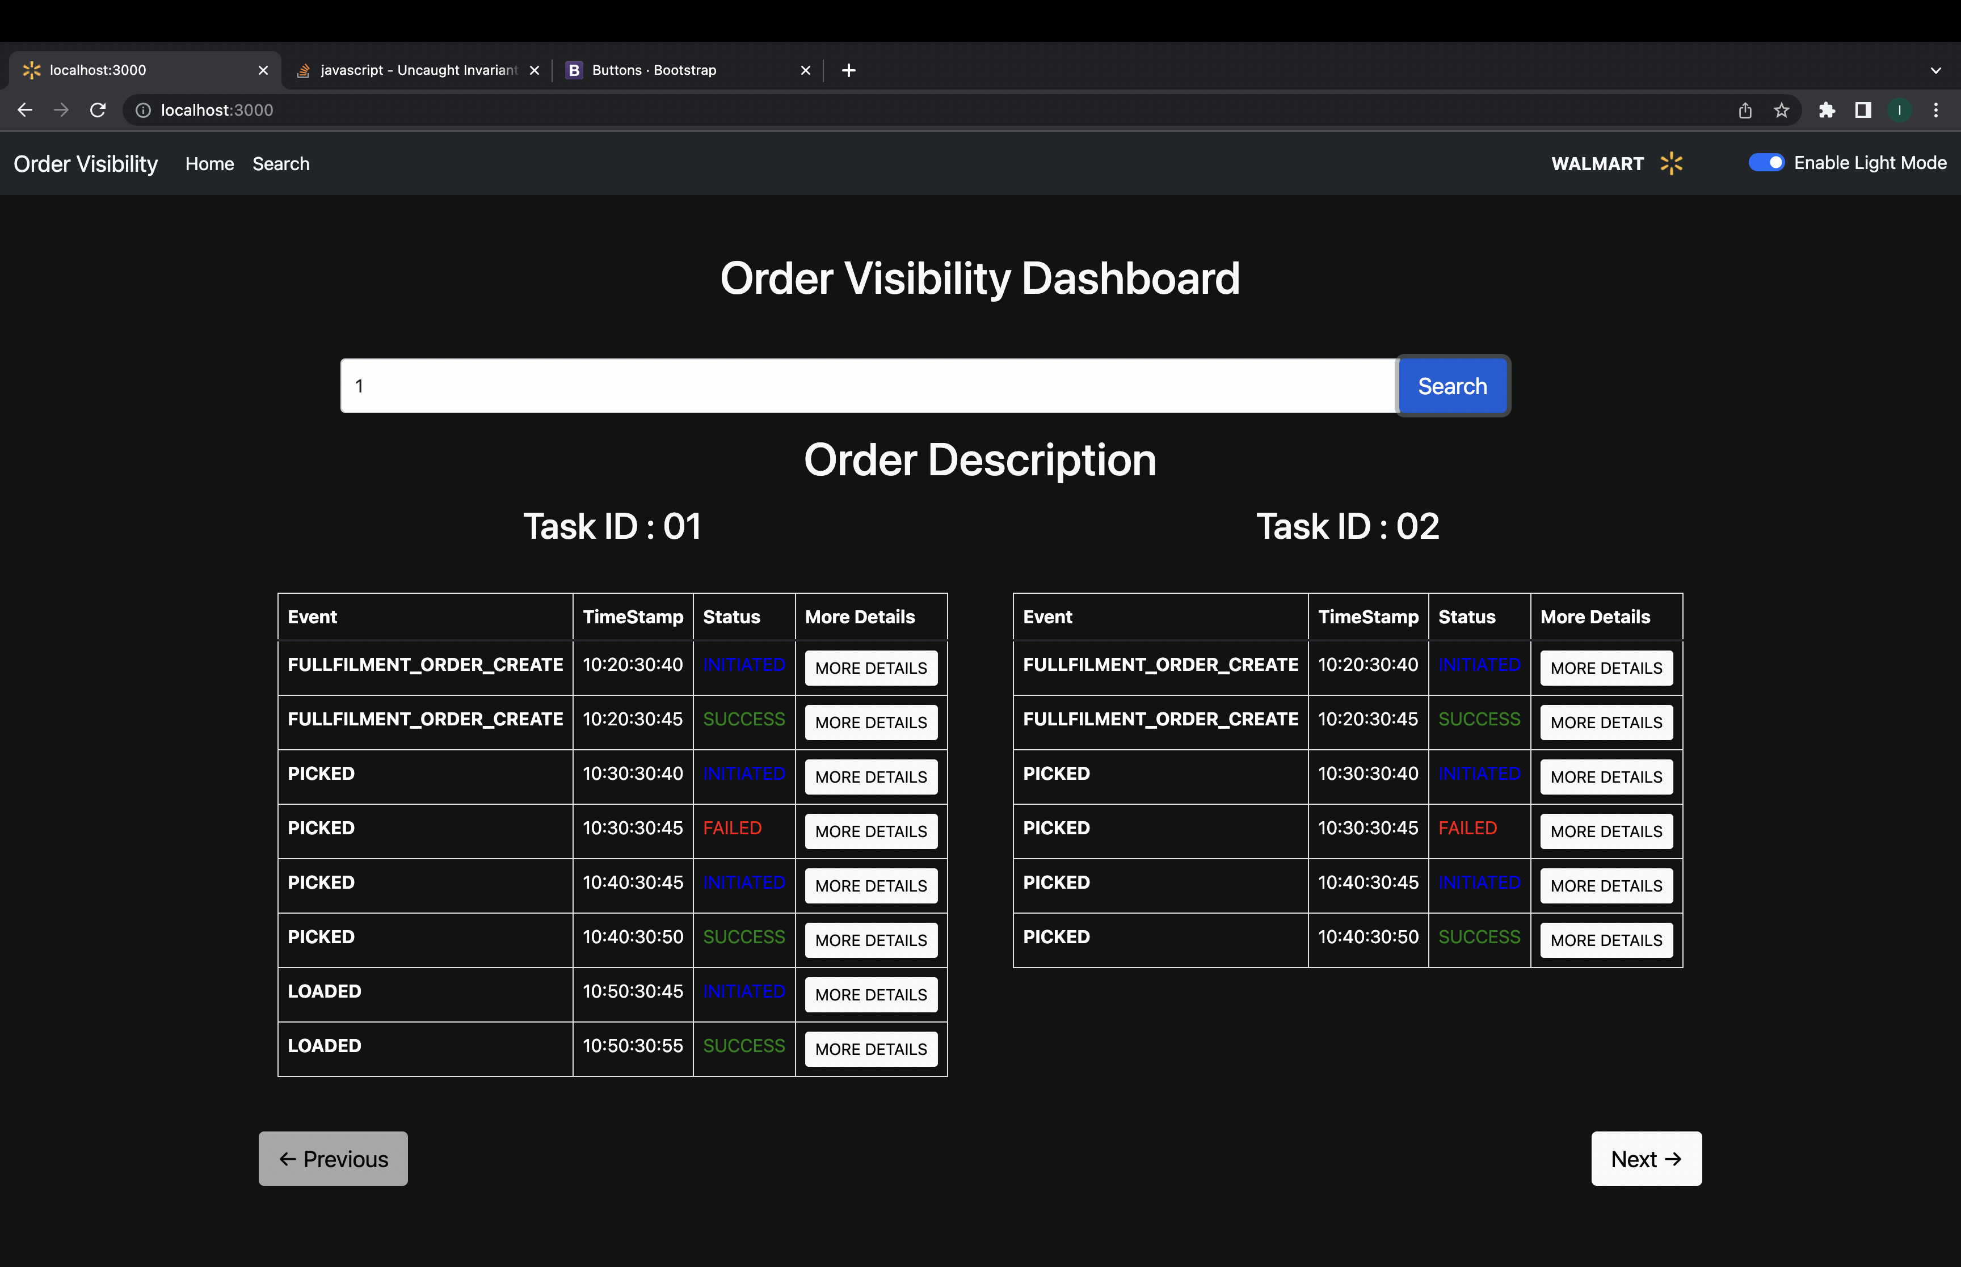
Snapshots for project

Slide 22
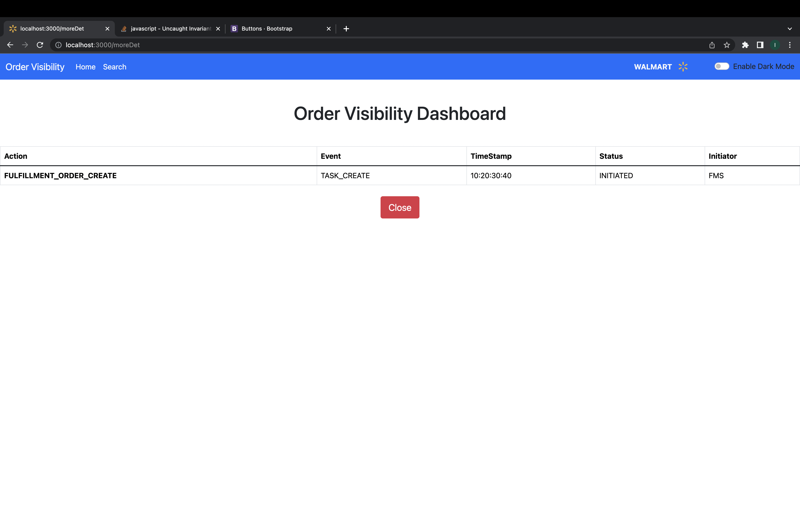
Snapshots for project

Slide 23
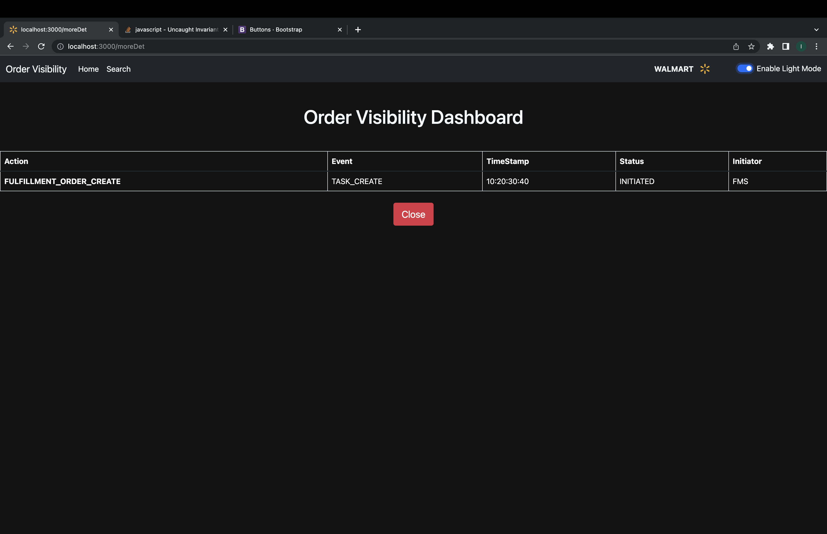
Snapshots for project

Slide 24
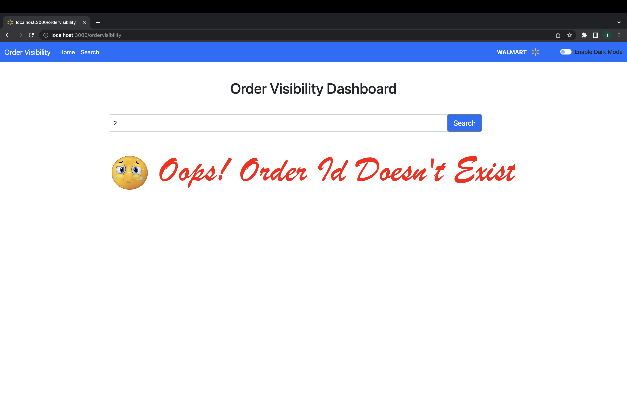
Snapshots for project

Slide 25
Thank you!
Presented By :
EN18IT301048 – Ishika Hadpawat

